Slide 1

SENTIMENT CLASSIFICATION AND OPINION MINING ON AIRLINE REVIEWS
DEVELOPED BY:
NAINENI SRAVANTHI
BAIRI ARAVIND
BINGI CHANDRA VAMSHI
MOHAMMED ABDUL KHALIQ

Slide 2

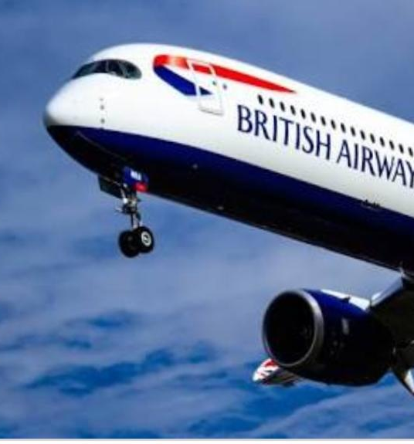
INTRODUCTION
Sentiment analysis refers to the use of natural language processing, text analysis, computational linguistics, and biometrics to systematically identify, extract, quantify, and study affective states and subjective information.
Opinion mining is also known as sentiment analysis.
Opinion mining or Sentiment Analysis means finding and classifying opinionated parts of texts. These subjective parts need to by identified by Text Mining methods and separated from objective text parts. A technique typically applied is the search for words which express opinion

Slide 3
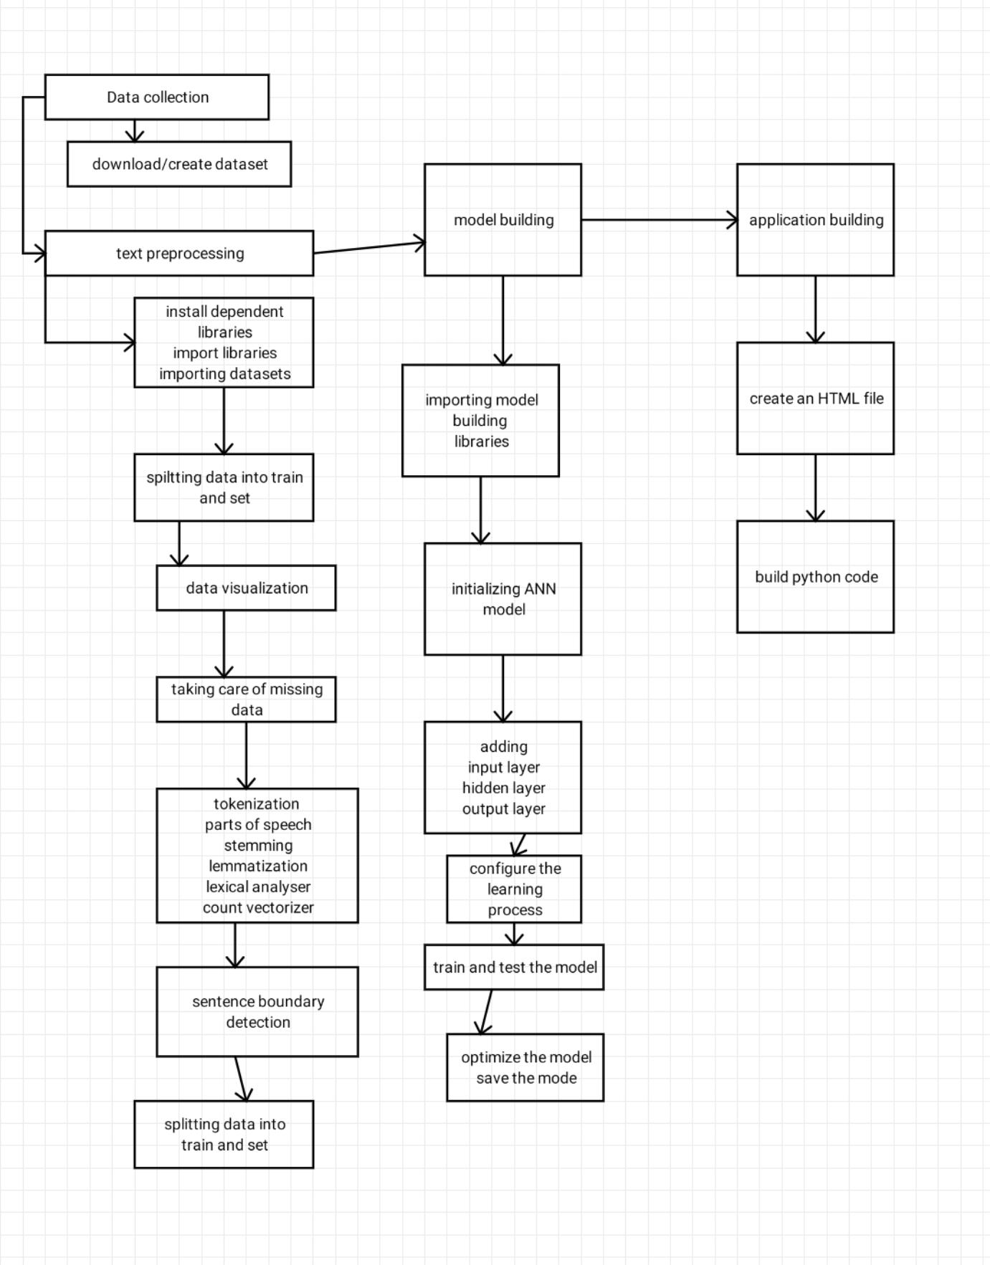
BLOCK DIAGRAM

Slide 4
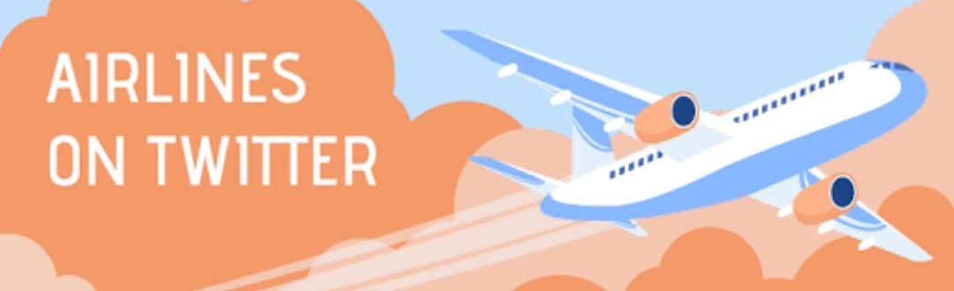
DATASET
Dataset used in this project is based on Twitter data of customer reviews on their travel experience in a particular airlines. It contains more than 14000 reviews of airline travellers with 15 attributes. We have used natural language processing methods to get accurate opinions and emotions of travellers on airline companies. These reviews mainly Taken in the form of positive, negative and neutral .

Slide 5

TOOLS USED
● Jupiter Notebook Environment ● Spyder

Slide 6
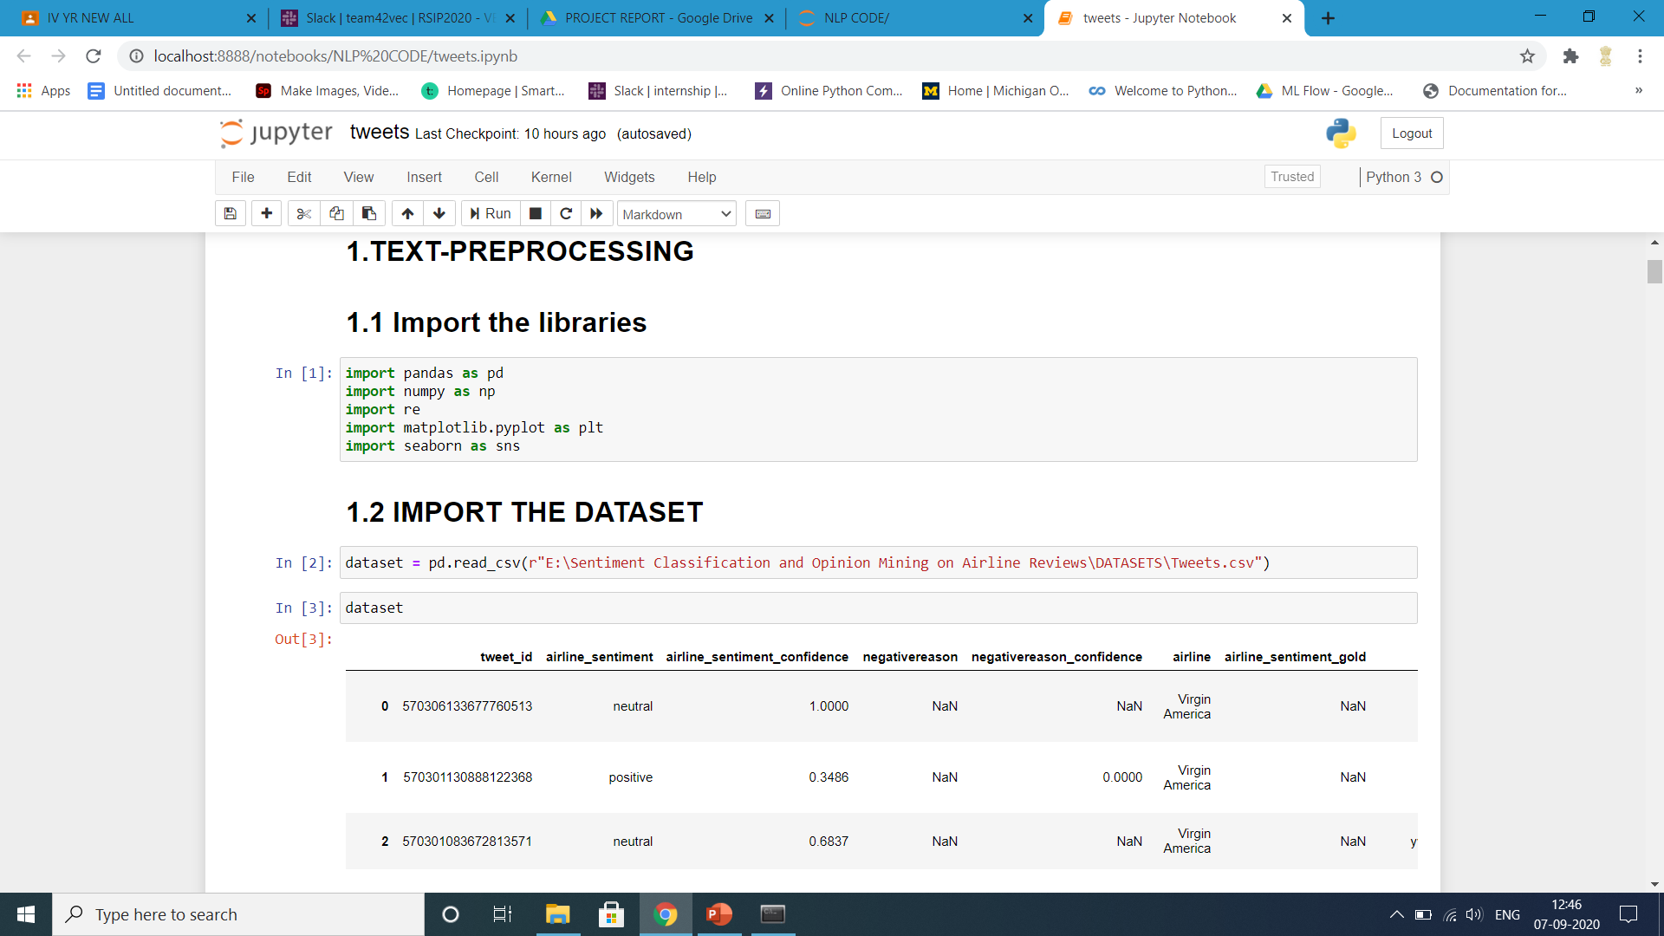
JUPYTER NOTEBOOK CODE

Slide 7
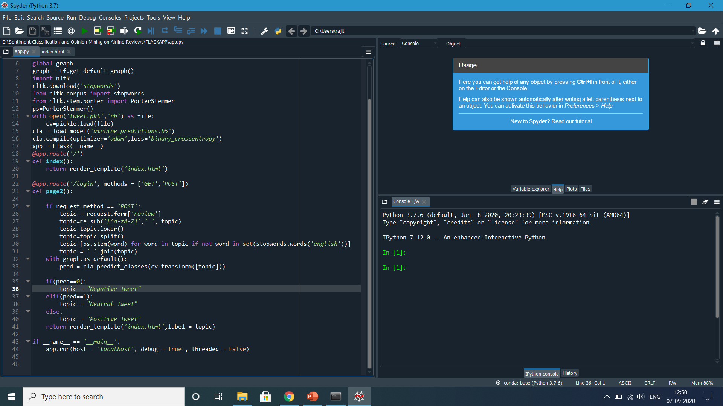
FLASK APP CODE

Slide 8
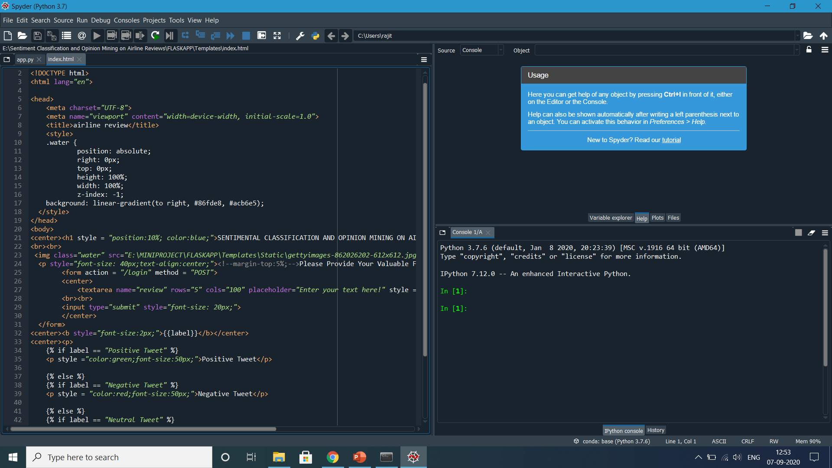
HTML CODE

Slide 9

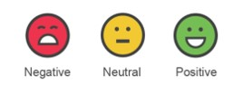
RESULT
By using sentiment analysis or opinion mining we can get accurate results based on the customer reviews on their travel experience in various airline companies. It helps airline companies to know therir customers feedback well. The results are in the form of positive, negative and neutral.

Slide 10

APPLICATIONS
It can be used to give your business valuable insights into how people feel about your product brand or service. When applied to social media channels, it can be used to identify spikes in sentiment, thereby allowing you to identify potential product advocates or social media influencers.

Slide 11

ADVANTAGES AND DISADVANTAGES
ADVANTAGES:- It can easily analyse the reviews Of customers on their travel experience It is very useful of airline companies to know their customers experience very well. DISADVANTAGES:- It cannot give complete 100% accurate results this the one of the main disadvantage.

Slide 12
CONCLUSION
At the present time, a large volume of information is available over Social Network like Twitter. Most Of contents may be opinions or comments, except those are the information or knowledge.
In addition, Opinions or comments are valuable in the decision making. Therefore, the application analyzing data About interesting services such as airline business on Twitter will be an actual useful assistance to Airline service customers and providers.

Slide 13

THANK YOU

